Slide 1
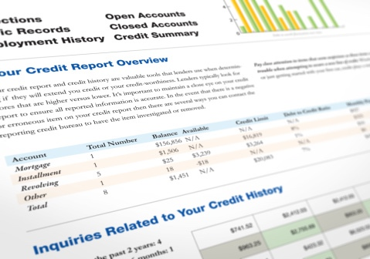
Module 6: Credit Reports and Scores
Credit SCORES

Slide 2
The Basics of Credit Scoring
Number calculated from information in credit reports
Generally, higher number = better credit history
Predicts likelihood of payment of credit obligations on time and as agreed
Two significant factors affect your credit scores:
Whether you repay debts on time and as agreed
Your credit utilization rate

Slide 3
More Basics of Credit Scoring
Multiple producers of credit scores
You likely have multiple credit scores
FICO® (Fair Isaac Corporation)
Vantage Score®
Others too
Different models for different types of credit

Slide 4
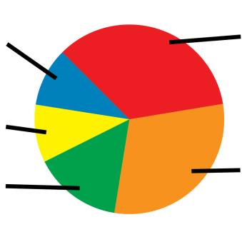
Five Factors in General FICO® Model
Payment History – 35%
New Credit – 10%
Credit Mix – 10%
Length of Credit History – 15%
Amounts Owed – 30%

Slide 5
Order Your Credit Scores
May not be the ones that are used
If turned down for credit, you have the right to see the exact score used
Make sure your credit scores accurately reflect information in your credit reports
Get and review your credit reports and dispute errors

Slide 6
What is a Good Credit Score?
Exceptional | 800 – 850
Very Good | 740 – 799
Good | 670 – 739
Fair | 580 – 669
Poor | 300 – 579
Note: this is an example, based on FICO®

Slide 7
Repair and Improve Credit
Get and review your credit reports
Dispute and correct any errors
Pay all your bills on time and as agreed
Use as little of your credit limit as possible
Use a credit building strategy
Keep old accounts open if you can
Apply for credit only if you need it
Negotiate different terms
Ask for a “good will” deletion

Slide 8
Build Alternative Credit History
Document other payments you regularly make, such as:
Rent
Childcare
Cell phone bill
Electric bill
Gas bill
Water, sewage, and garbage bills
Television service bill
Internet service bill
Insurance payments
Loan from friend or family member
Savings

Slide 9
Build Credit
Get a secured credit card
Get a credit-building loan
Become an authorized user on an account
Get a cosigner
Apply for a credit card at a store or gas station
Make a large down payment and negotiate a loan for the balance

Slide 10
Maintain Credit
Pay your bills on time and as agreed
Continue to pay down your debt balances
Keep the proportion of the credit you use low compared with credit limits
Don’t apply for too much credit
Avoid actions or inactions that may create new entries
Pay your taxes and child support in full and on time
Check your credit reports and regularly dispute errors
Keep good financial records

Slide 11
Get Help
Financial institution
Nonprofit consumer credit counseling service
Housing Counseling Agency approved by Department of Housing and Urban Development (HUD)
Financial education nonprofit organization
Certified Financial Planners (CFPs)
Other

Slide 12
Credit Repair and Debt Consolidation
Credit Repair Companies
Promise to fix your credit for a fee
Debt Consolidation Businesses
Offer different services
Often specialize in debt consolidation loans and debt settlement services

Slide 13
Use Caution
Debt consolidation
Taking out new loan to pay off other debts
Does not address underlying causes of debt
Debt settlement
Working with creditors to accept lower payment and settle debt
Might have to pay income tax on portion that was settled

Slide 14
Credit Repair Scams
Beware of credit repair companies that:
Promise to erase bad credit or remove other negative, but accurate, information
Promise fast and easy credit repair
Offer to create a new identity for you
Want you to pay upfront
Will not tell you about your rights

Slide 15
Protecting Your Credit History
Initial fraud alert
Active-duty military alert
Extended fraud alert
Credit freeze
Credit lock

Slide 16
Presented By Huntington Bank
Julie Caballero
Branch Manager
Huntington Bank Cicero
Office: 708-656-6330
Julissa.caballero@huntington.com
NMLS 1236154
5310 W Cermak Rd Cicero IL 60804
Webpage: WWW.HUNTINGTON.COM
Jennifer Walter
Agent
New York Life Insurance Company
Cell: (630) 361-2402
jlwalter01@ft.newyorklife.com
CA License # 4305991
2001 Butterfield Rd #800, Downers Grove, IL 60515

