Slide 1
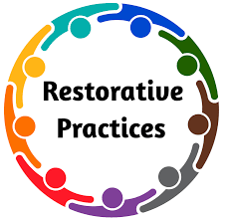
Learning, Leveraging, and Listening With Restorative Practices
Tauya Forst, J.D., M.S. johnsont217@cod.edu
Richard Forst, J.D. forstlaw@sbcglobal.net

Slide 2
Restorative AGENDA
Define Restorative Practices (RP)
Explain processes of RP
Origins of Restorative Practices (RP)
Check-Out
Explain participants in RP
Check-In

Slide 3
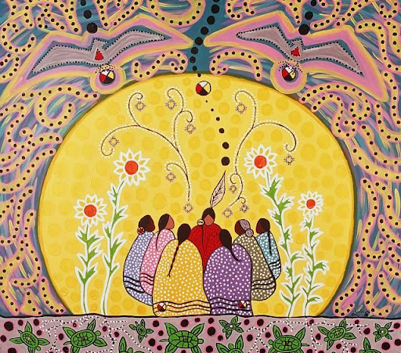
ORIGINS OF PEACEMAKING CIRCLES

Slide 4
Indigenous Land acknowledgement

Slide 5
Restorative Practices Definition
Restorative Practices is an umbrella term used for strategies that help us to proactively build community, relationships, and manage conflict and tensions. These strategies center on treating ALL humans with dignity and respect, while elevating equal voice.
Notes:
Restorative Practices (RP) is an approach that helps people to strengthen relationships, build community, and prevent conflict.

Slide 6
RESTORATIVE PRACTICES
RESTORATIVE SCHOOLS
RESTORATIVE JUSTICE
RESTORATIVE TEXTBOOKS
RESTORATIVE DIVORCE
RESTORATIVE POLICING
RESTORATIVE RELATIONSHIPS
Notes:
Restorative Justice is a community and victim-centered sentencing philosophy that emphasizes offender accountability and responsibility through negotiated restitution.

Slide 7
Restorative Practices PARTICIPANTS
Person Who Created Harm
Person Who Was Harmed
Community
Restorative Process with Talking Piece
What is the point of restorative practices?
Notes:
Wrongdoer is the person who inflicts harm. This individual may have different names depending upon the environment where the harm has occurred.
For example, in a restorative justice context, the wrongdoer is the offender. Whereas in a school setting the wrongdoer may be a student who hit a teacher in class.
The Harmed is the person who receives the harm executed by the wrongdoer. Again, the harmed has many names.
For example, in a restorative justice context, the harmed is the victim. Whereas in a school environment, the harmed may be a teacher who was hit by a student in class.
The community is the area and space in which the harm occurred. Community is important to restorative practices as the voice of vested stakeholders help hope the wrongdoer accountable. The verbiage of restorative practices is one of the many ways that it differs from other methods of engagement for issues of harm. It is the verbiage which helps set the proverbial stage for all those impacted by the harm to work towards a collaborative effort to repair the harm.

Slide 8
This is a traditional meeting.
How can we create a more restorative meeting?
Circle (win-win)

Slide 9
Restorative Practices Facilitation Processes
Pre -Conferencing
Responsive circles
Restorative conferences
Problem-solving,
Restorative plans
Proactive circles
Check-In/
Check-Out
Community building circles
Problem-solving circles,
Peer mediation
GOAL for Proactive Circle – Foster and Create Community.
GOAL for Responsive Circle – To reduce the results to a writing, plan, or contract.

Slide 10
RESTORATIVE PRACTICES - EQUAL VOICE
AND FAIR PROCESS
Notes:
https://www.managementcenter.org/resources/using-fair-process-to-make-better-decisions-a-quick-start-guide/

Slide 11
Affective Statements
uneasy when
worried when
I am..
excited when…
happy when
uncomfortable when
Affective statements, referred to as “I” statements tell the listener, how the person feels and why it makes them feel that way.
I am ____(state the impact)____
When ____(identify the behavior)____
What I’d like is ___(state the preferred action)___

Slide 12
Affective Statements APPLICATION
Formulating an affective statement:
I am ____(state the impact)____
When ____(identify the behavior)____
What I would like is ___(state the preferred action)___
Example: I am disturbed when I hear people on my team gossip about one another. What I would like is for these team members to communicate directly with one another and discuss their issues or challenges in a constructive manner.

Slide 13
Respect
What is Restorative Practices?
The 5 Rs
Relationship
Reintegration
Responsibility
Repair

Slide 14
Check-in
My name is _______________
My most important accomplishment is
________________________
Notes:
Purpose of the Check-In show vulnerability,, engage around easy and calm topics before tackling some of the more difficult topics. Check-Ins can be used in a stand alone circle or as part of the pre-conference.

Slide 15
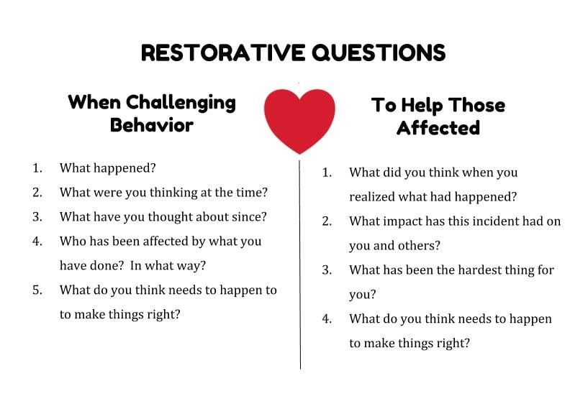
Restorative QUESTIONS
What is the point of restorative practices?

Slide 16
Degrees of restorative justice practices: a continuum
Pseudo- or non-restorative
Potentially restorative
Partially restorative
Mostly restorative
Fully restorative
Notes:
All programs are not created equal.

Slide 17
CHECK-OUT
Name one area in your life that you can apply Restorative Practices.
What steps would you take to do it?
Notes:
Purpose of the Check-Out is to remind us of community and the learning which we have equally shared in.

Slide 18
Learning, Leveraging, and Listening With Restorative Practices
Thank you! Questions?
Tauya Forst, J.D., M.S. johnsont217@cod.edu
Richard Forst, J.D. forstlaw@sbcglobal.net

